Slide 1
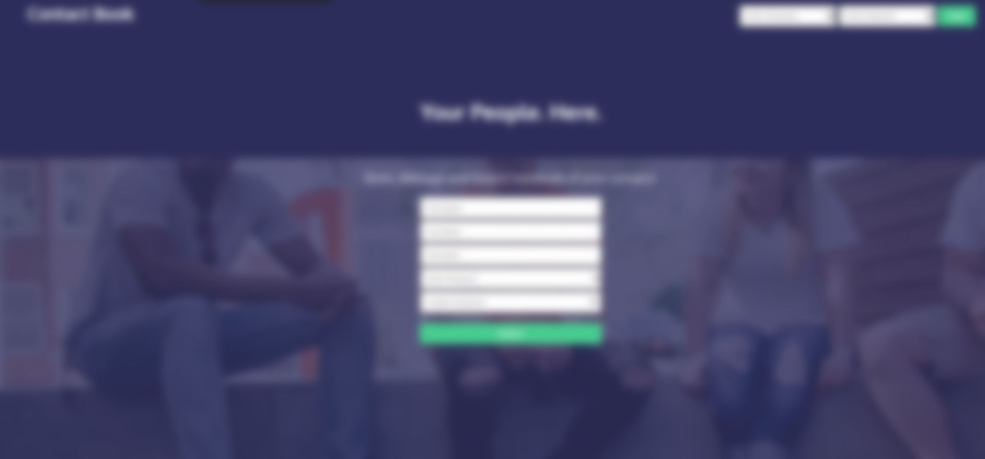
Group 11’s Contact Manager

Slide 2
Meet the team
Database
Carlos Lairet
API
Devon Anselmo
Harry O’Hagan
Project Manager
Cameron Garretson
Front-End
Neo Cho
Zachary Sutrich

Slide 3
Tech Used
Version Control: Github
General Discussion: Discord
Group Meetings: Zoom
Project Management: Trello
Hosting: GoDaddy
Languages: SQL, PHP, HTML/CSS, JavaScript
Database Management: MySQL
Testing: ARC
Presentation: PowerPoint
Charts: Excel, ERDPlus
Notes:
In progress, don’t know what other languages used

Slide 4
What went wrong
Fundamental design issue with regards to search contact functionality.
PHP syntax and API in general.

Slide 5
What went right
The team.
Collaboration between different departments, ie. API team working with Front-End.
Debugging API endpoints with ARC.
Designing the website before touching code.
Notes:
Waiting for group input

Slide 6
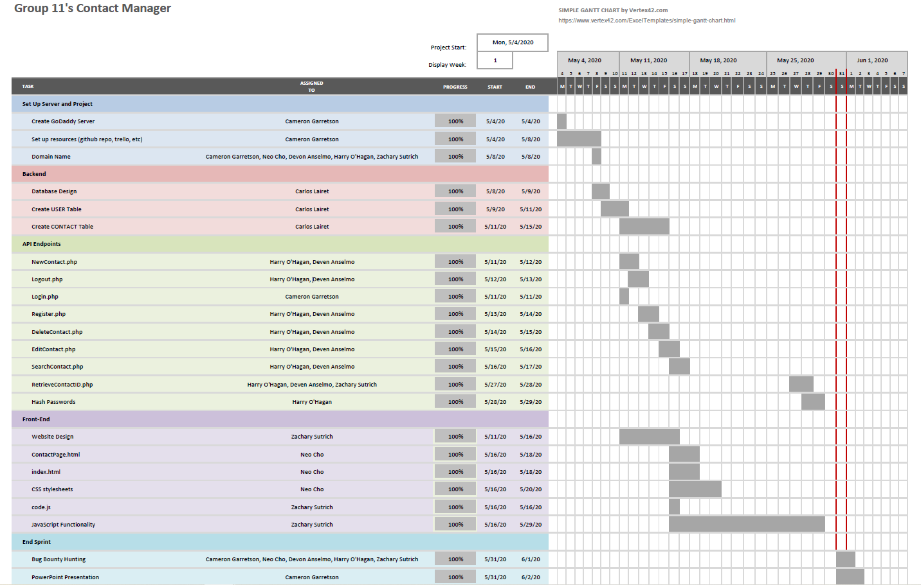
Gantt Chart

Slide 7
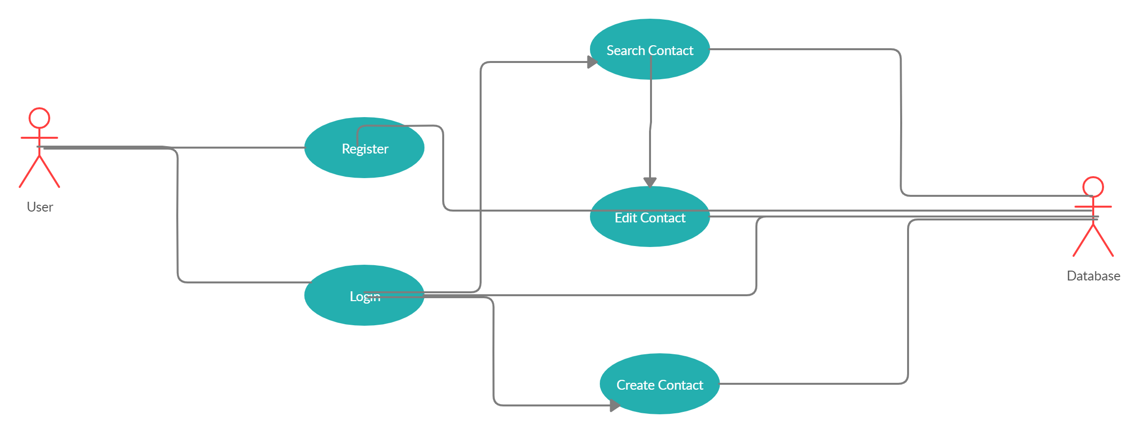
Use Case Diagram

Slide 8
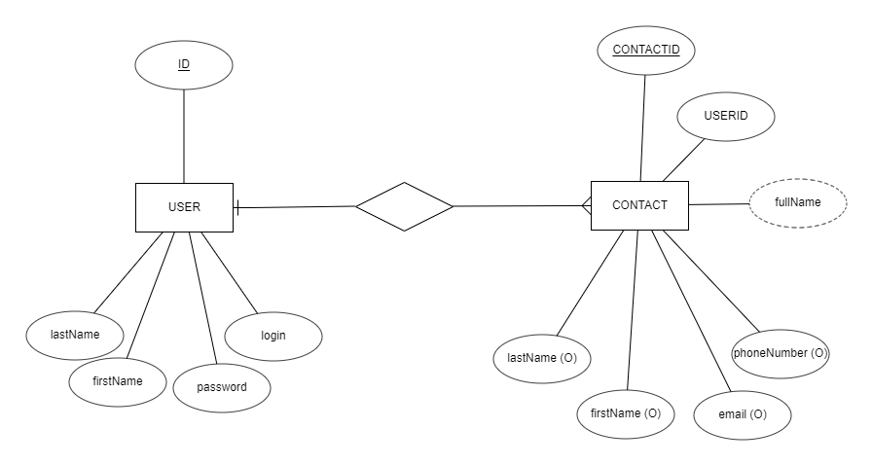
ERD
Notes:
Include legend?

Slide 9
Project Breakdown

Slide 10
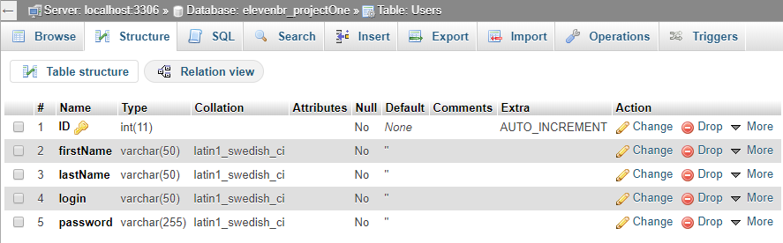
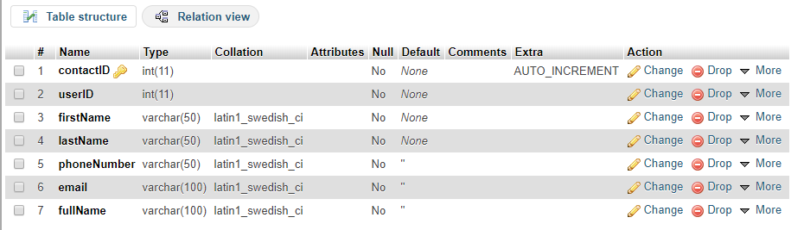
Database
-Carlos Lairet

Slide 11
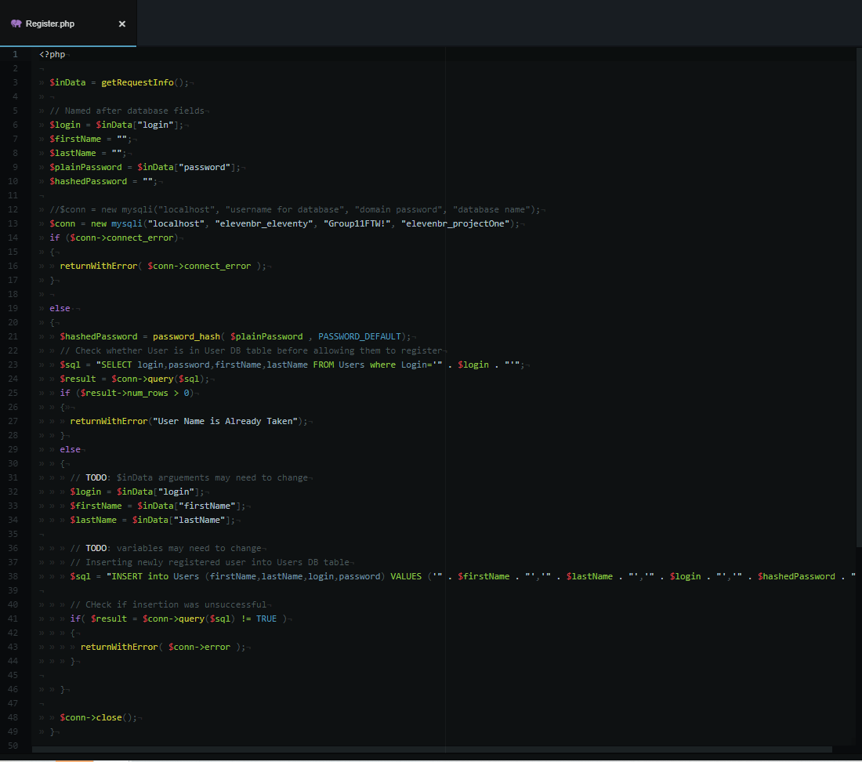
API Endpoints
-Harry O’Hagan

Slide 12
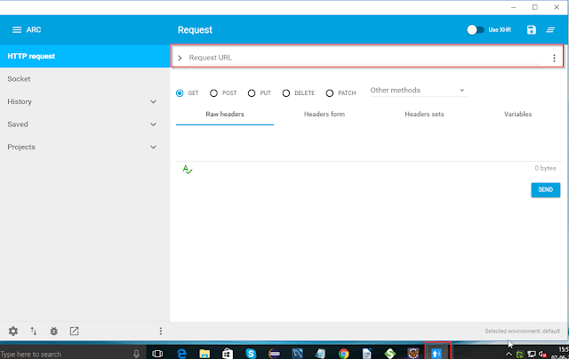
API ARC Testing
-Devon Anselmo

Slide 13

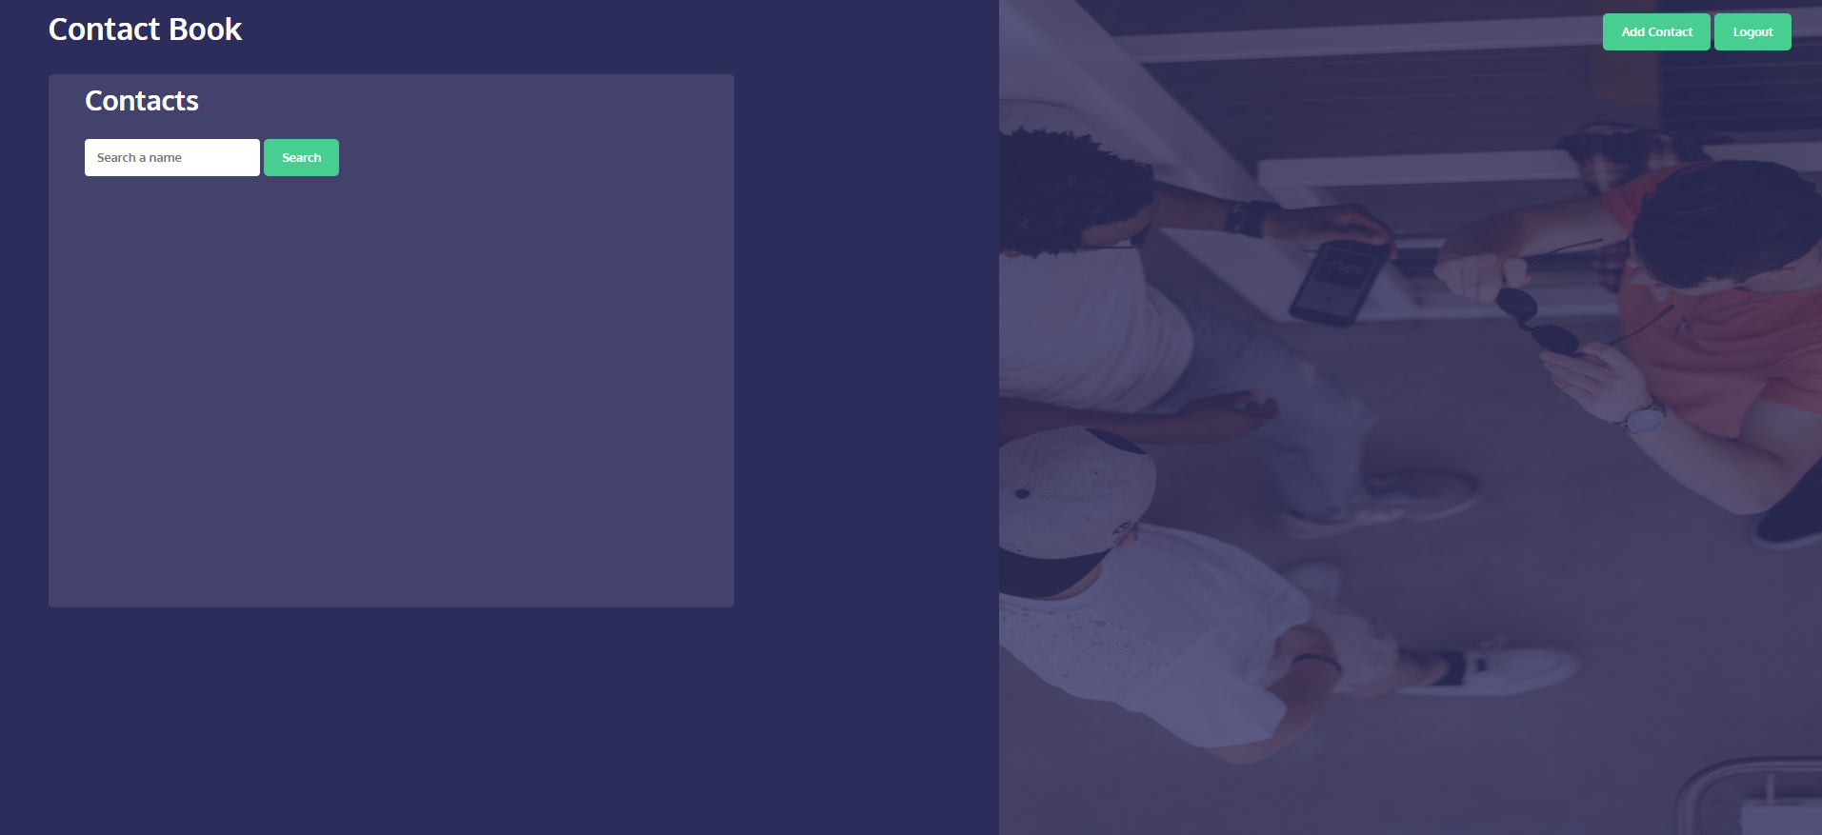
Website Design
-Neo Cho

Slide 14
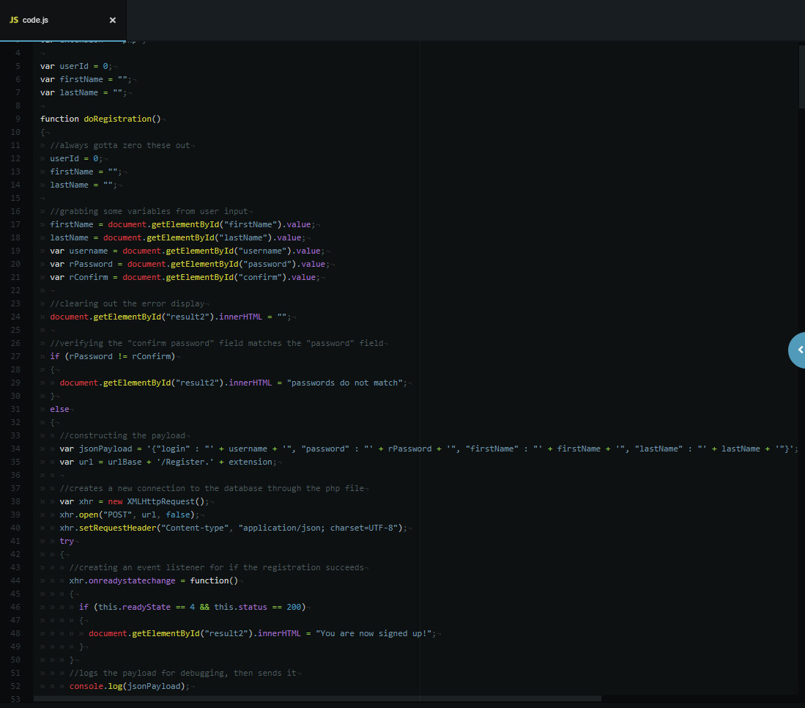
JavaScript
-Zachary Sutrich

Slide 15
App Demo
https://elevenbrethren.com/index.html

Slide 16
Questions

